Slide 1

In the Moment of Heat!
ME 766: Course Project
Samyak Shah, 18D070062
Akshit Shrivastava, 180110008
Souvik Pal, 18D110011
Rohan Pipersenia, 180110064

Slide 2
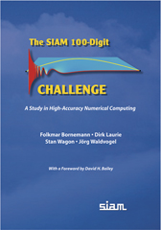
Problem Statement
All the problems in SIAM’s 100 Digit Challenge takes one through the thrilling tour of some of the most interesting problems and techniques in numerical mathematics.
These problems provide an amazing opportunity to apply the theoretical and programming concepts and skills learnt during our course.
One of the powerful applications of High Performance Computing is solving PDEs, we took a problem which would demonstrate this power of HPSC
Picture Credits – Siam Publishers

Slide 3
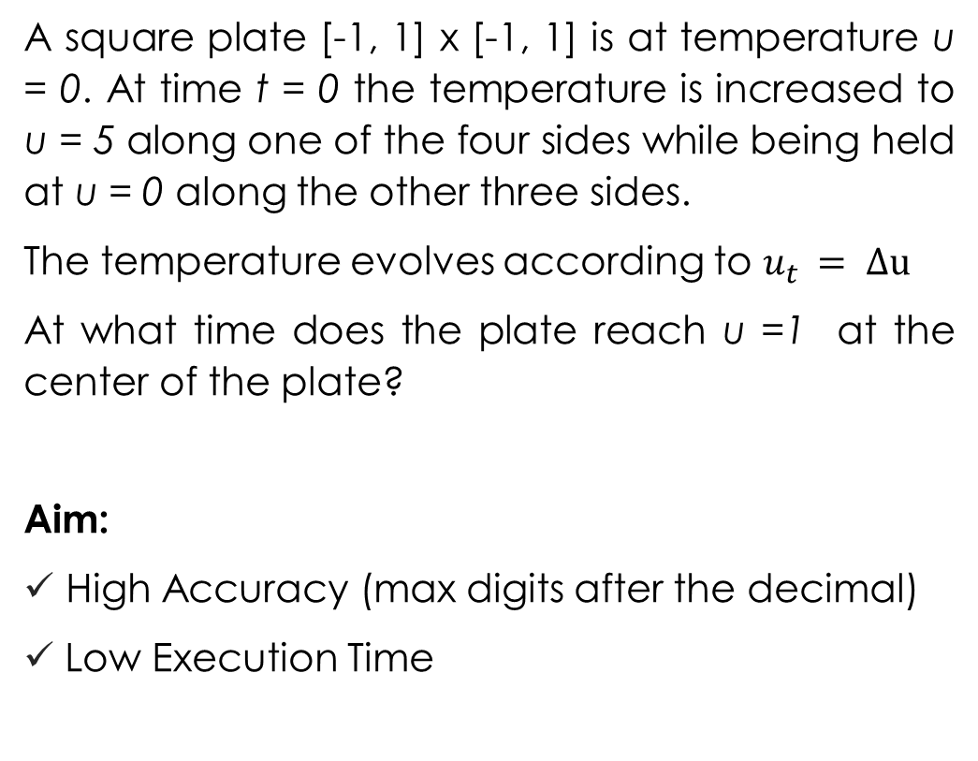
In the Moment of Heat
A square plate [-1, 1] x [-1, 1] is at temperature u = 0. At time t = 0 the temperature is increased to u = 5 along one of the four sides while being held at u = 0 along the other three sides.
The temperature evolves according to $u_{t }= Δu$
At what time does the plate reach u =1 at the center of the plate?
Aim:
High Accuracy (max digits after the decimal)
Low Execution Time
SIAM := Society for Industrial & Applied Mathematics

Slide 4
Methodology Programming Language: Python
OpenCL kernels (linear operators) to apply the numerical scheme.
Inverse of matrix using Conjugate Gradient Method
Sparse Incomplete LU Decomposition to make a preconditioner matrix
Use Numba to accelerate the python functions
Secant Method for finding out the final solution

Slide 5
Methodology Programming Language: Python
Numba
Numba is an open source JIT compiler that translates a subset of Python and NumPy code into fast machine code
Numba-compiled numerical algorithms in Python can approach the speeds of C or FORTRAN.
PyOpenCL
PyOpenCL lets us access GPUs and other massively parallel compute devices from Python. It tries to offer computing goodness in the spirit of its sister project PyCUDA
Automatic Error Checking. All errors are automatically translated into Python exceptions.
You don't need to replace the Python interpreter, run a separate compilation step, or even have a C/C++ compiler installed. Just apply one of the Numba decorators to your Python function, and Numba does the rest.
Follows RAII (Resource Acquisition is Initialization) like C++.

Slide 6


The Algorithm Organisation After flattening the lattice: $$α= τ/{2h^{2}}$$ b is the boundary conditions h is a small spatial step; $τ$ is a small time step
$$A_{t+1}u_{h, n+1}=A_{t}u_{h, n}+2αb$$
Construct $A_{t+1}$ and $A_{t}$ as OpenCL kernels
Construct 𝐴_(𝑡+1) and 𝐴_𝑡 as OpenCL kernels
Construct the preconditioned P to find the inverse of $A_{t+1}$
Construct the preconditioned P to find the inverse of 𝐴_(𝑡+1)
Use the secant method to find the solution of the problem
Detailed derivation included in the report

Slide 7
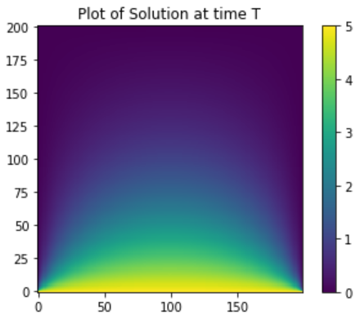
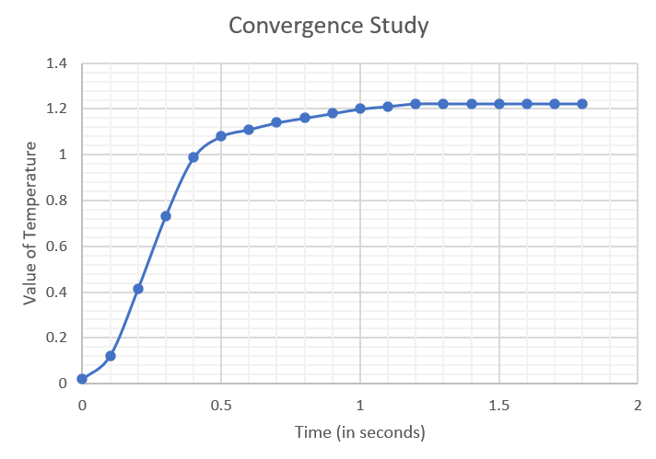
Visualising the heat flow
The figure on the right shows the temperature at time T. At time T, the center of the square plate is a temperature u = 1.
The figure below shows the convergence of the temperature value at the center of the square plate

Slide 8
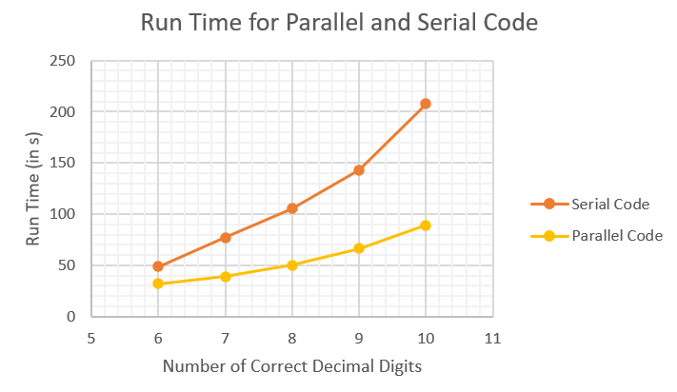
Parallel v/s Serial Code
Observations:
The time to obtain every additional correct digit increases exponentially after that.
We observe that the speedup value increases for a higher number of correct digits behind the decimal point. The speedup value lies between 1.5 to 2.5 for our analysis.
Our parallel code is a very good option, much better than the serial code if we want to get a very exact answer in a short time.

Slide 9
References and Sources
Bornemann F., Laurie D., Wagon S., Waldvogel J., The SIAM 100-Digit Challenge: A Study in High-Accuracy Numerical Computing, February 2003

Slide 10
Work Distribution
All the work and ideas were discussed in the group before implementation. Since, the work was very collaborative it is difficult to categorize who did what. But below is a rough work distribution
Samyak Shah: Ideation, Code Debugging, Code Documentation, Presentation Designs
Akshit Shrivastava: Code Implementation, Code Documentation, Report
Souvik Pal: Ideation, Code Debugging, Visualising the data, Report
Rohan Pipersenia: Code Implementation, Code Documentation, Report

